Slide 1

GLOBAL ACADEMY OF TECHNOLOGY DEPARTMENT OF COMPUTER SCIENCE AND ENGINEERING
Subject Name | Project Work(Phase 2) | Subject Code | 15CSP78
Student Name | Praveen G | USN | 1GA15CS109
 | Reshma P |  | 1GA15CS121
 | Sanjana B |  | 1GA15CS130
 | Prajwal K L |  | 1GA15CS105
Domain | Internet Of Things and machine learning | Group No: | G-33
Project Title | “ Border line security with human detection system”
Under taken at | Global Academy Of Technology
Guide Name | Mrs. Jyothi R

Slide 2

Agenda
Introduction
Problem Statement
Objectives
Existing System
Proposed System
System Architecture
High Level Design
Bibliography

Slide 3

Introduction
About
Domain

Slide 4
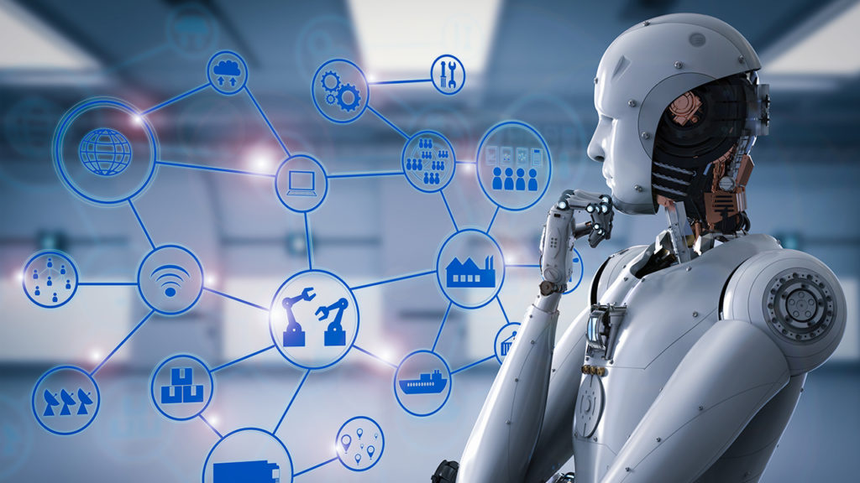
Internet Of Things
Internet of Things is all about connecting various devices by using internet and letting them communicate with each other and the remote server.
Main idea behind the IoT is to extract the various values from various sensors which are attached to various objects by connecting them to the network and automating the actions performed by the object or a system.
According to IDC, worldwide market of internet of things is going to grow up around $1.7 trillion up to 2020
Current research is leading the robotics field to use the internet thus giving birth to the new term “Internet of Robotics”

Slide 5

Machine Learning
Artificial neural networks are one of the main tools used in machine learning. As the “neural” part of their name suggests, they are brain-inspired systems which are intended to replicate the way that we humans learn
HOW WILL IT LEARN ?
In the same way that we learn from experience in our lives, neural networks require data to learn. In most cases, the more data that can be thrown at a neural network, the more accurate it will become.

Slide 6

Problem Statement
Border Line Security with Human
Detection System

Slide 7

OBJECTIVES

Slide 8

The proposed system differentiates between animal and human and detects if the human being is a suspect or not in any catastrophic environment.
Deployment of ground sensors (IR sensors and Ultrasonic Sensors)
On high signal of IR and Ultrasonic sensor, camera starts recording.
Raising an alarm on human detection across border using camera and artificial neural network algorithms.
The system finds out unauthorised people in border areas and send notifications to commanders so that tracking can be possible

Slide 9

EXISTING SYSTEM

Slide 10
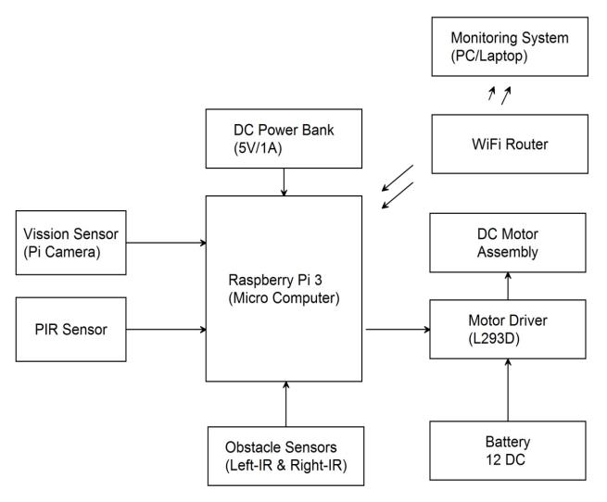
Existing System
The existing system uses PIR sensors which can detect only within 10 meters.
This system uses AI technique for detection of human.

Slide 11

Disadvantages of the existing system
The use of PIR sensors is a major drawback as it can detect only 10 meters.
Requires high cost to set up communication between robot and rescue control.
The use of AI techniques is quite limited.
Could not detect if the robot was destroyed.

Slide 12

PROPOSED SYSTEM

Slide 13
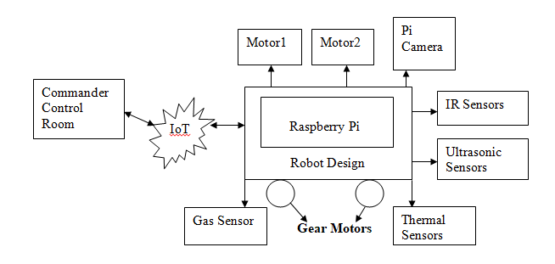
Proposed System
The received image from the robot will be further processed by ANN.
The system differentiates between animal and human and detects any suspect.
Few other features such as detecting hazardous gas , sending signal if the robot is destroyed are being added.

Slide 14
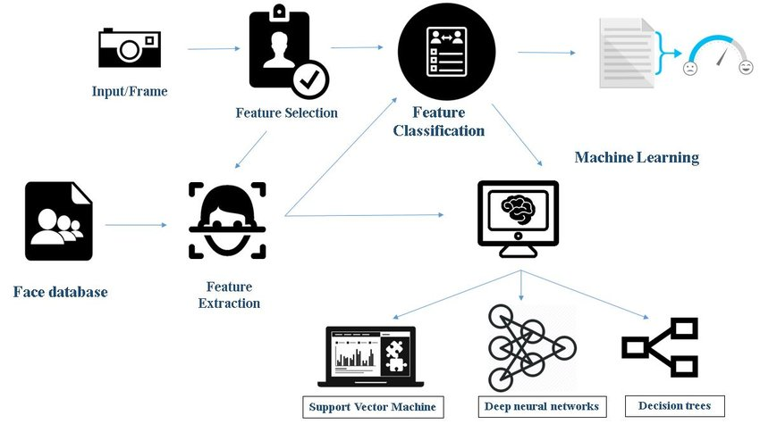
PROPOSED SYSTEM

Slide 15
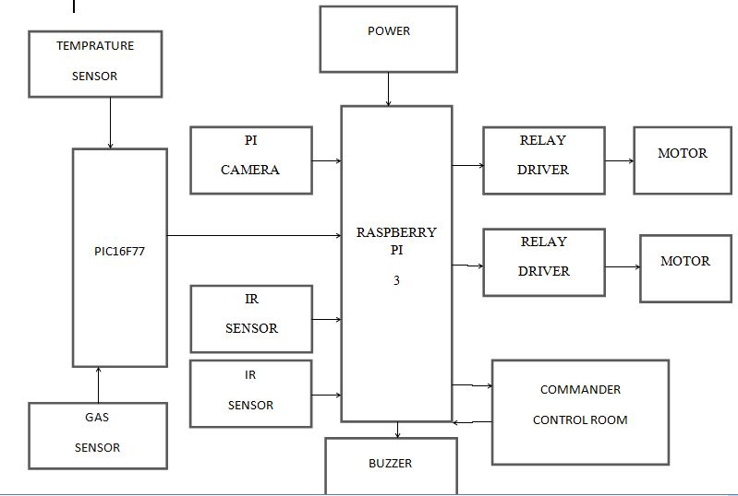
System Architecture

Slide 16
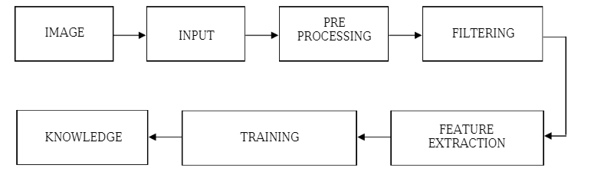
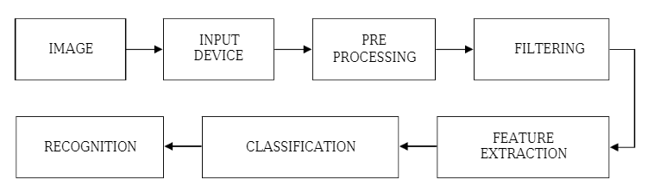
System Architecture
TRAINING PROCESS
TESTING PROCESS

Slide 17
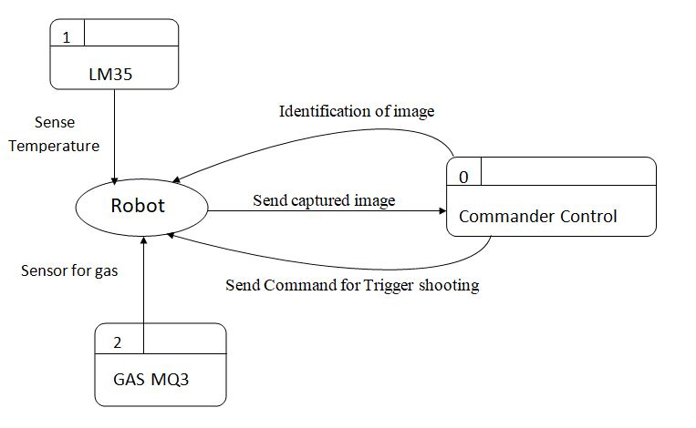
High Level Design

Slide 18
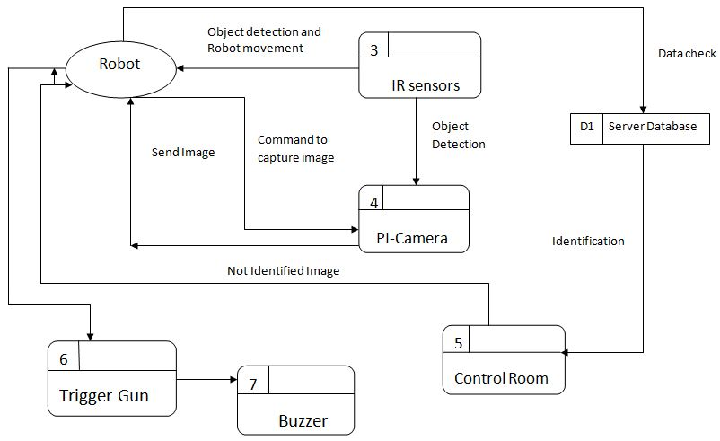
High Level Design

Slide 19
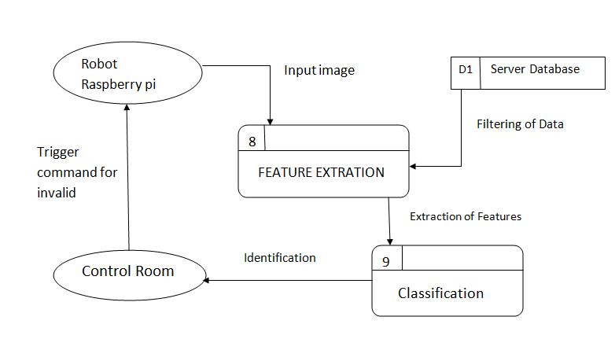
High Level Design

Slide 20
MODULES

Slide 21
MODULES

Slide 22
MODULES

Slide 23
IMPLEMENTATION
[fn pn] = uigetfile({'*.jpg';'*.bmp';'*.tif';'*.gif';'*.png'},'Select Image File');
complete = strcat(pn,fn);
pic1=(imread (complete));
figure,imshow(pic1);
title('Input Image');
load Decision;
c1=0;c2=0;c3=0;c4=0;c5=0;c6=0;
det=[];
d1=WavData1(complete);
d1=mean(d1);
yfit=treeval(T,d1);
tc = fitctree(Train,class)
if(yfit==1)
disp('HUMAN');msgbox('HUMAN');
c1 = d1;
det=1
elseif(yfit==2)
disp('NOT HUMAN');msgbox('NOT HUMAN');
c2 = d1;
det=0
else
disp('Invalid Input');msgbox('Invalid Input');
end

Slide 24
IMPLEMENTATION

Slide 25
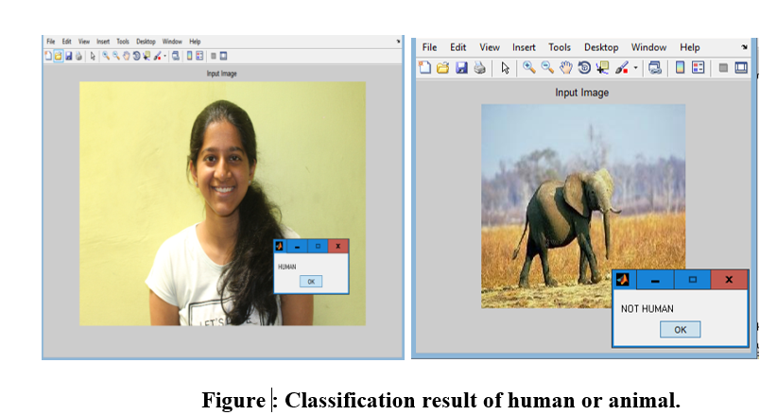
TESTING

Slide 26
TESTING

Slide 27
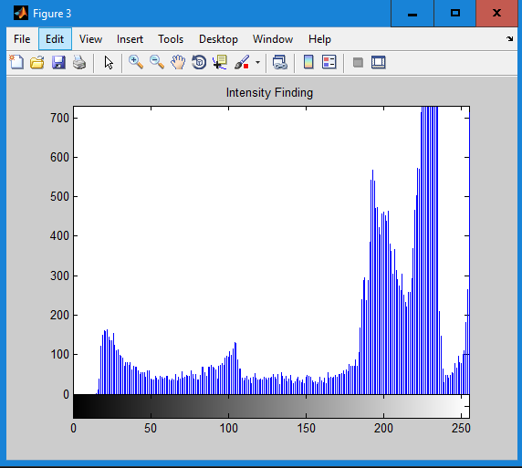
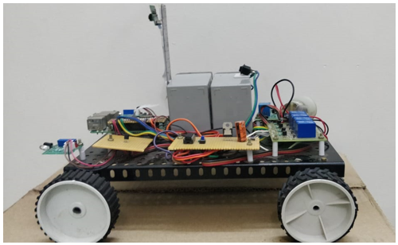
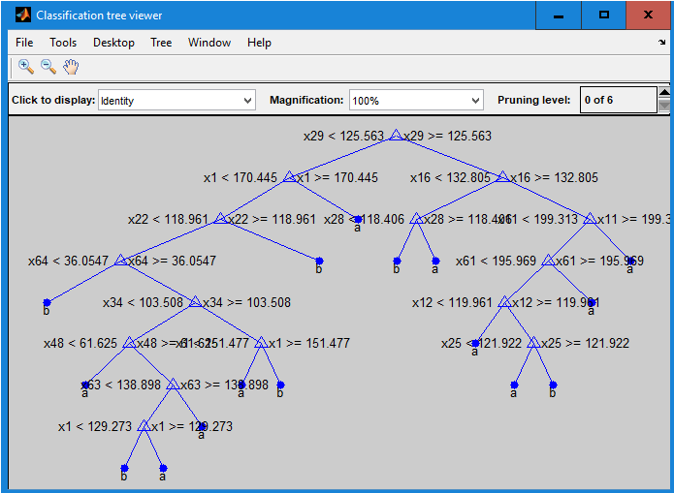

RESULTS

Slide 28
CONCLUSION
The Robot navigates freely based on the sensor status.
Capture the image of an unknown folk and send it to the web page.
Detect the gas and the thermal values based on the sensor and provide information to the web page.
Monitor the information present on the web page, and control accordingly with various buttons.
Furthermore the analysis between the human and animal is classified.

Slide 29
Bibliography
[1] Ghanem Osman Elhaj Abdalla, T. Veeramanikandasamy, “Implementation of Spy Robot for A Surveillance System using Internet Protocol of Raspberry Pi”, IEEE, 2017, 86-89, May 2017
[2] Jürgen Schmidhuber, “Deep learning in neural network: An overview”, Elsevier, Vol. no 61, 2015, 85-117, January 2015

Slide 30
Thank You
Under guidance of Mrs Jyothi R

Slide 31


